Slide 1



Real-Time Dynamic Vehicle Routing for Emergency Services
Guided By:
Dr Gnanajeyaraman Rajaram
Saveetha School of Engineering
Chennai
Presented By:
G.Raju(192411065)
P.Sai Bhargav(192411049)

Slide 2



Abstract
Emergency services require fast, reliable, and efficient vehicle routing to reach critical locations on time.
Traditional routing systems may not handle traffic congestion, accidents, road closures, and changing road conditions effectively.
The proposed system uses real-time traffic and road information to select the best available route.
The road network is represented using a graph structure, where roads and locations are treated as connected nodes and edges.
Dijkstra’s Algorithm and A* Algorithm are used to calculate efficient routes for emergency vehicles.

Slide 3
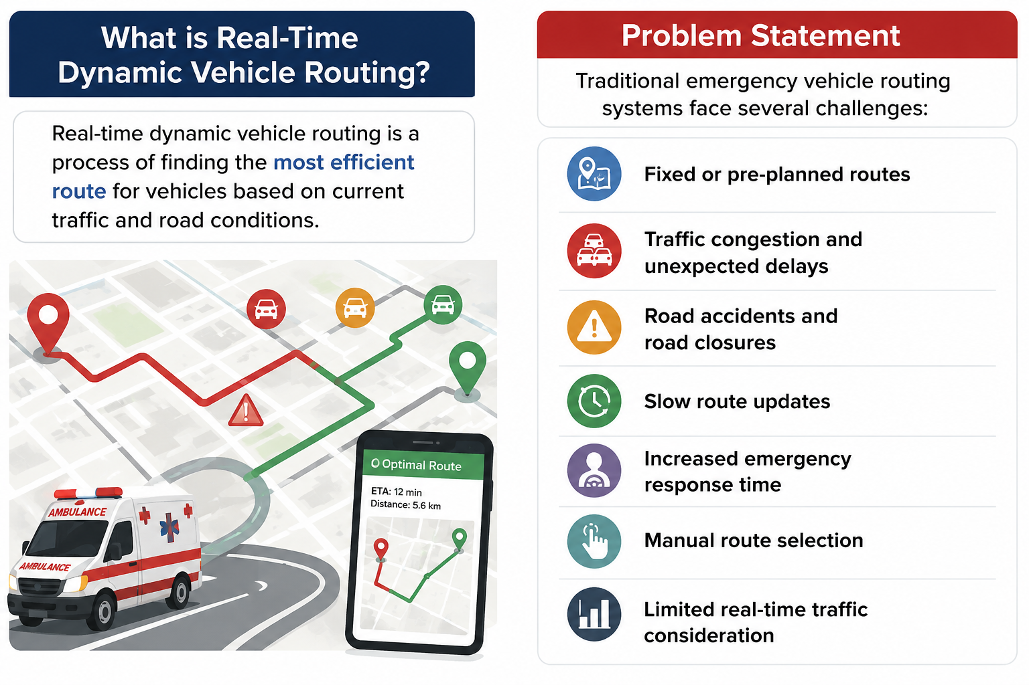
Introduction
What is Real-Time Dynamic Vehicle Routing?
Real-time dynamic vehicle routing is a process of finding the most efficient route for vehicles based on current traffic and road conditions.
Problem Statement
Traditional emergency vehicle routing systems face several challenges:
Fixed or pre-planned routes
Traffic congestion and unexpected delays
Road accidents and road closures
Slow route updates
Increased emergency response time
Manual route selection
Limited real-time traffic consideration

Slide 4
Literature Survey
Paper / Journal | Year | Author(s) | Work Addressed
A Dynamic Vehicle Routing Problem with Time Windows | 2020 | M. Azi, S. Gendreau, J.-Y. Potvin | Studied dynamic vehicle routing with changing requests and time constraints to improve route efficiency.
Real-Time Traffic-Aware Routing for Emergency Vehicles | 2021 | S. Chen, Y. Wang | Proposed traffic-aware routing methods using real-time road conditions to reduce emergency vehicle travel time.
Dynamic Shortest Path Algorithms for Road Networks | 2022 | P. Sanders, D. Schultes | Investigated efficient shortest-path techniques for large road networks with changing travel conditions.
A Search Algorithm for Intelligent Vehicle Routing* | 2023 | R. Kumar, A. Singh | Applied A* search for faster route calculation using distance and heuristic information.

Slide 5

Research Gap
Existing Systems :
Mostly designed for fixed or static routing.
Limited support for real-time traffic conditions.
Manual intervention is often required for route changes.
Limited handling of accidents, road closures, and congestion.
proposed system :
Combining real-time traffic monitoring with dynamic routing.
Supporting automatic route selection and re-routing.
Using Dijkstra’s and A* algorithms for route optimization.
Providing continuous vehicle tracking and route monitoring.

Slide 6


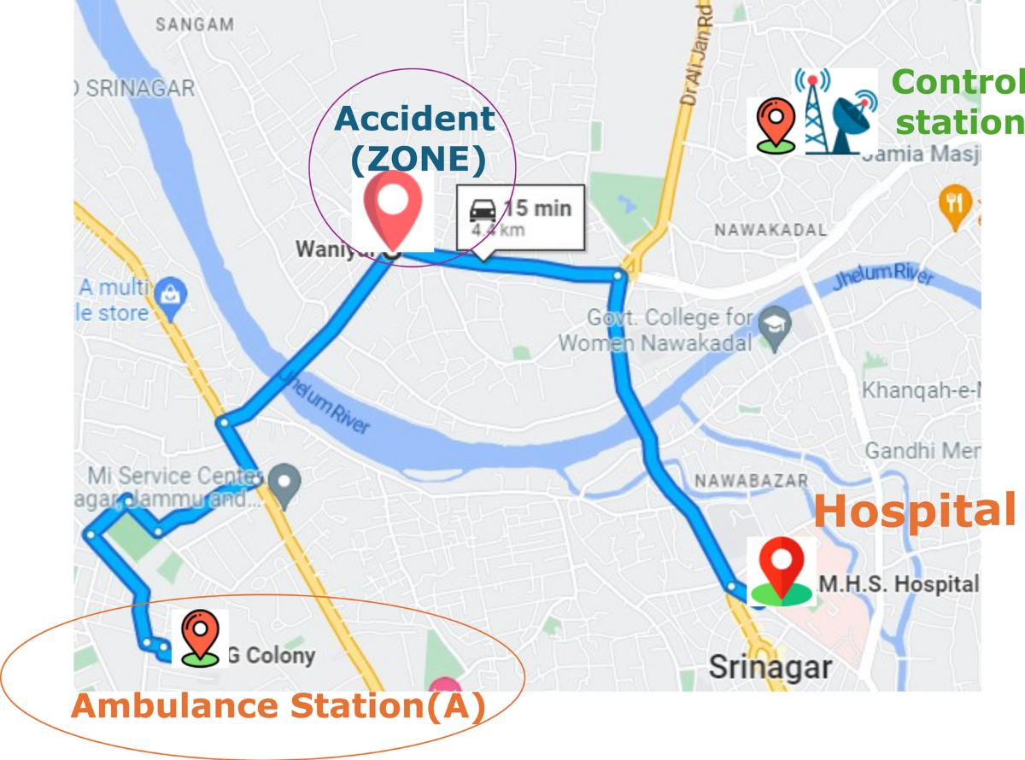
Proposed Objectives
Develop a real-time emergency vehicle routing system.
Monitor traffic and road conditions continuously.
Enable automatic route selection and dynamic re-routing.
Minimize emergency response time and travel delays.
Optimize routes using Dijkstra’s and A* algorithms.
Provide real-time vehicle tracking and route monitoring.

Slide 7
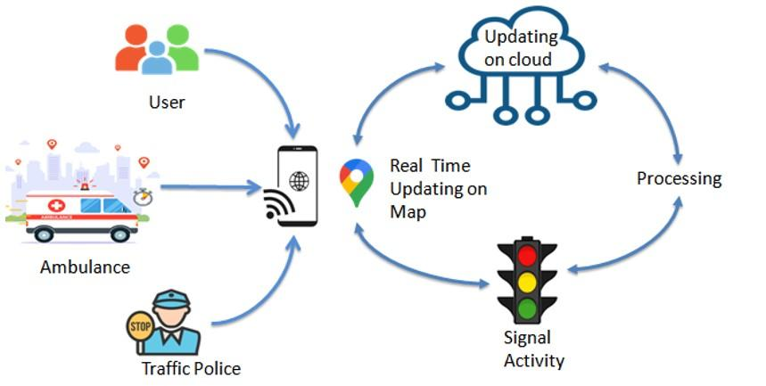
Proposed System

Slide 8
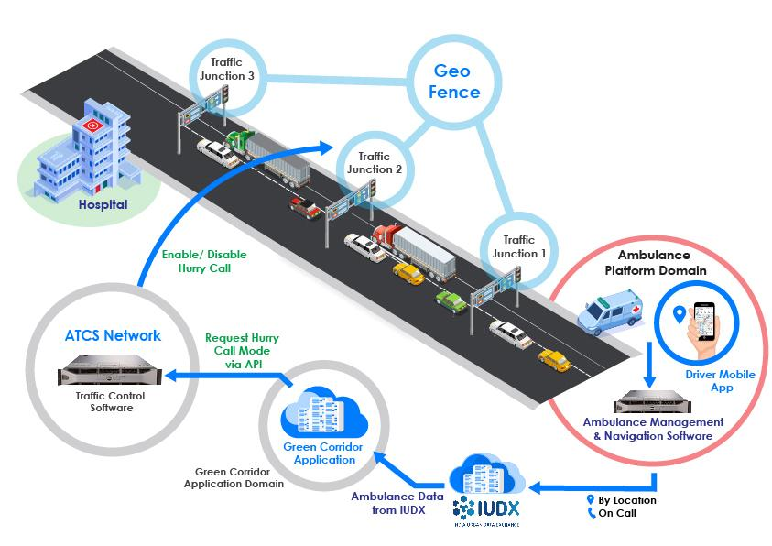
Modules
Modules
Module 1: Emergency Request & Vehicle Management
Module 2: Real-Time Traffic Monitoring

Slide 9
Module 1:Emergency Request & Vehicle Management
Objective:
Provide fast emergency request processing and assign a suitable available vehicle.
Key Functions:
Emergency request registration
Vehicle registration and management
Identify emergency location
Identify destination location
Check vehicle availability
Assign nearest suitable vehicle
Input:
Emergency location
Destination
Vehicle details
Emergency type
Output:
Assigned emergency vehicle
Validated emergency request
Vehicle status
Technologies:
HTML + CSS + JavaScript + Python + SQLite

Slide 10
Module 2: Real-Time Traffic Monitoring
Input:
Traffic data
Road conditions
Vehicle location
Output:
Updated traffic information
Congestion status
Available road status
Technologies:
Traffic API + GPS + Python + Database
Objective:
Monitor current traffic and road conditions to support efficient emergency routing.
Key Functions:
Collect real-time traffic information
Monitor traffic congestion
Detect road accidents
Identify road closures
Update road travel time
Continuously refresh traffic conditions

Slide 11
Algorithm Comparison
Algorithm / Approach | Main Purpose | Route Selection | Speed | Dynamic Updates | Best Use
Dijkstra’s Algorithm | Finds shortest path | Shortest path | Moderate | Limited | Basic road networks
A* Algorithm | Finds efficient path | Shortest/efficient path | Fast | Limited | Large road networks
Dynamic Re-Routing | Updates route based on conditions | Fastest current route | Fast | High | Emergency services

Slide 12
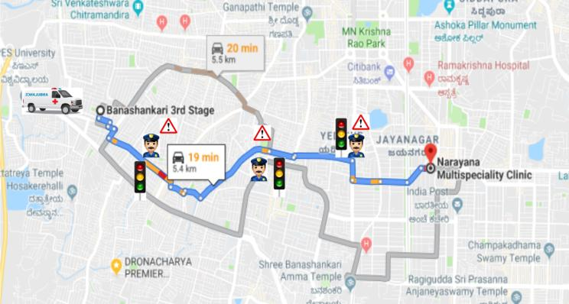
Conclusion
Developed an intelligent real-time dynamic vehicle routing system for emergency services.
Utilized Dijkstra’s and A* algorithms to identify efficient emergency routes.
Enabled dynamic re-routing based on changing traffic and road conditions.
Reduced travel delays and emergency response time through optimized route selection.
Improved the overall efficiency and reliability of emergency vehicle operations.

Slide 13
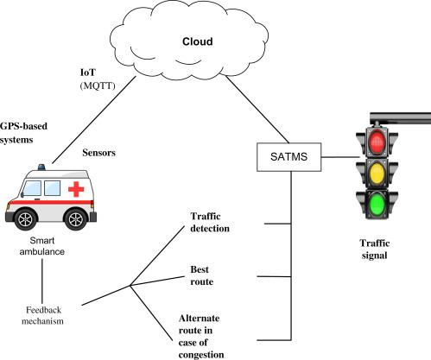
Future Enhancements
AI-Based Traffic Prediction
– Predict future traffic congestion.
Automatic Accident Detection
– Detect accidents and road blockages automatically.
Multiple Vehicle Coordination
– Coordinate multiple emergency vehicles efficiently.
Cloud-Based Routing
– Provide scalable real-time routing services.
IoT-Based Traffic Monitoring
– Collect live traffic and road-condition data.
Mobile Application Support
– Monitor vehicles and routes through mobile devices.

Slide 14


